Slide 1
OFAF Monitor

Slide 2
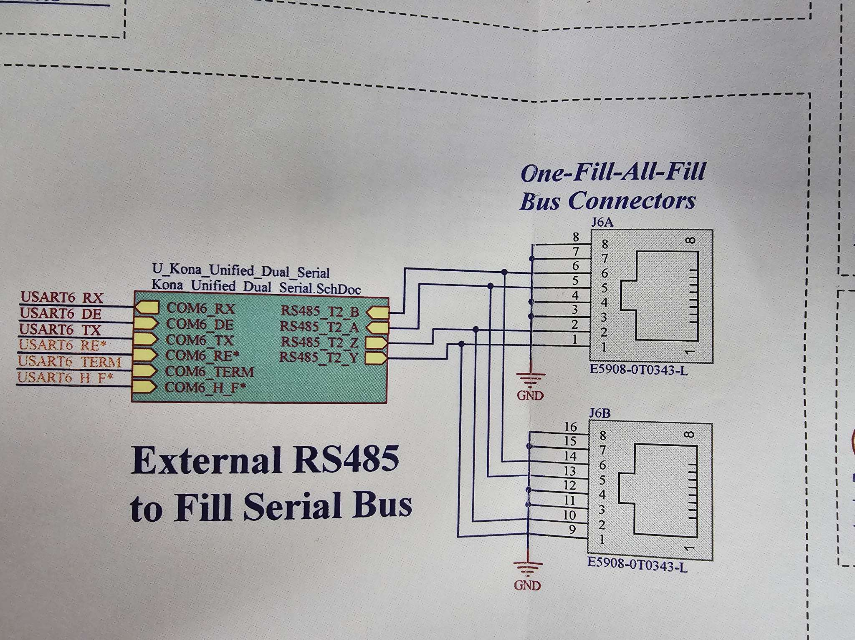

Slide 3
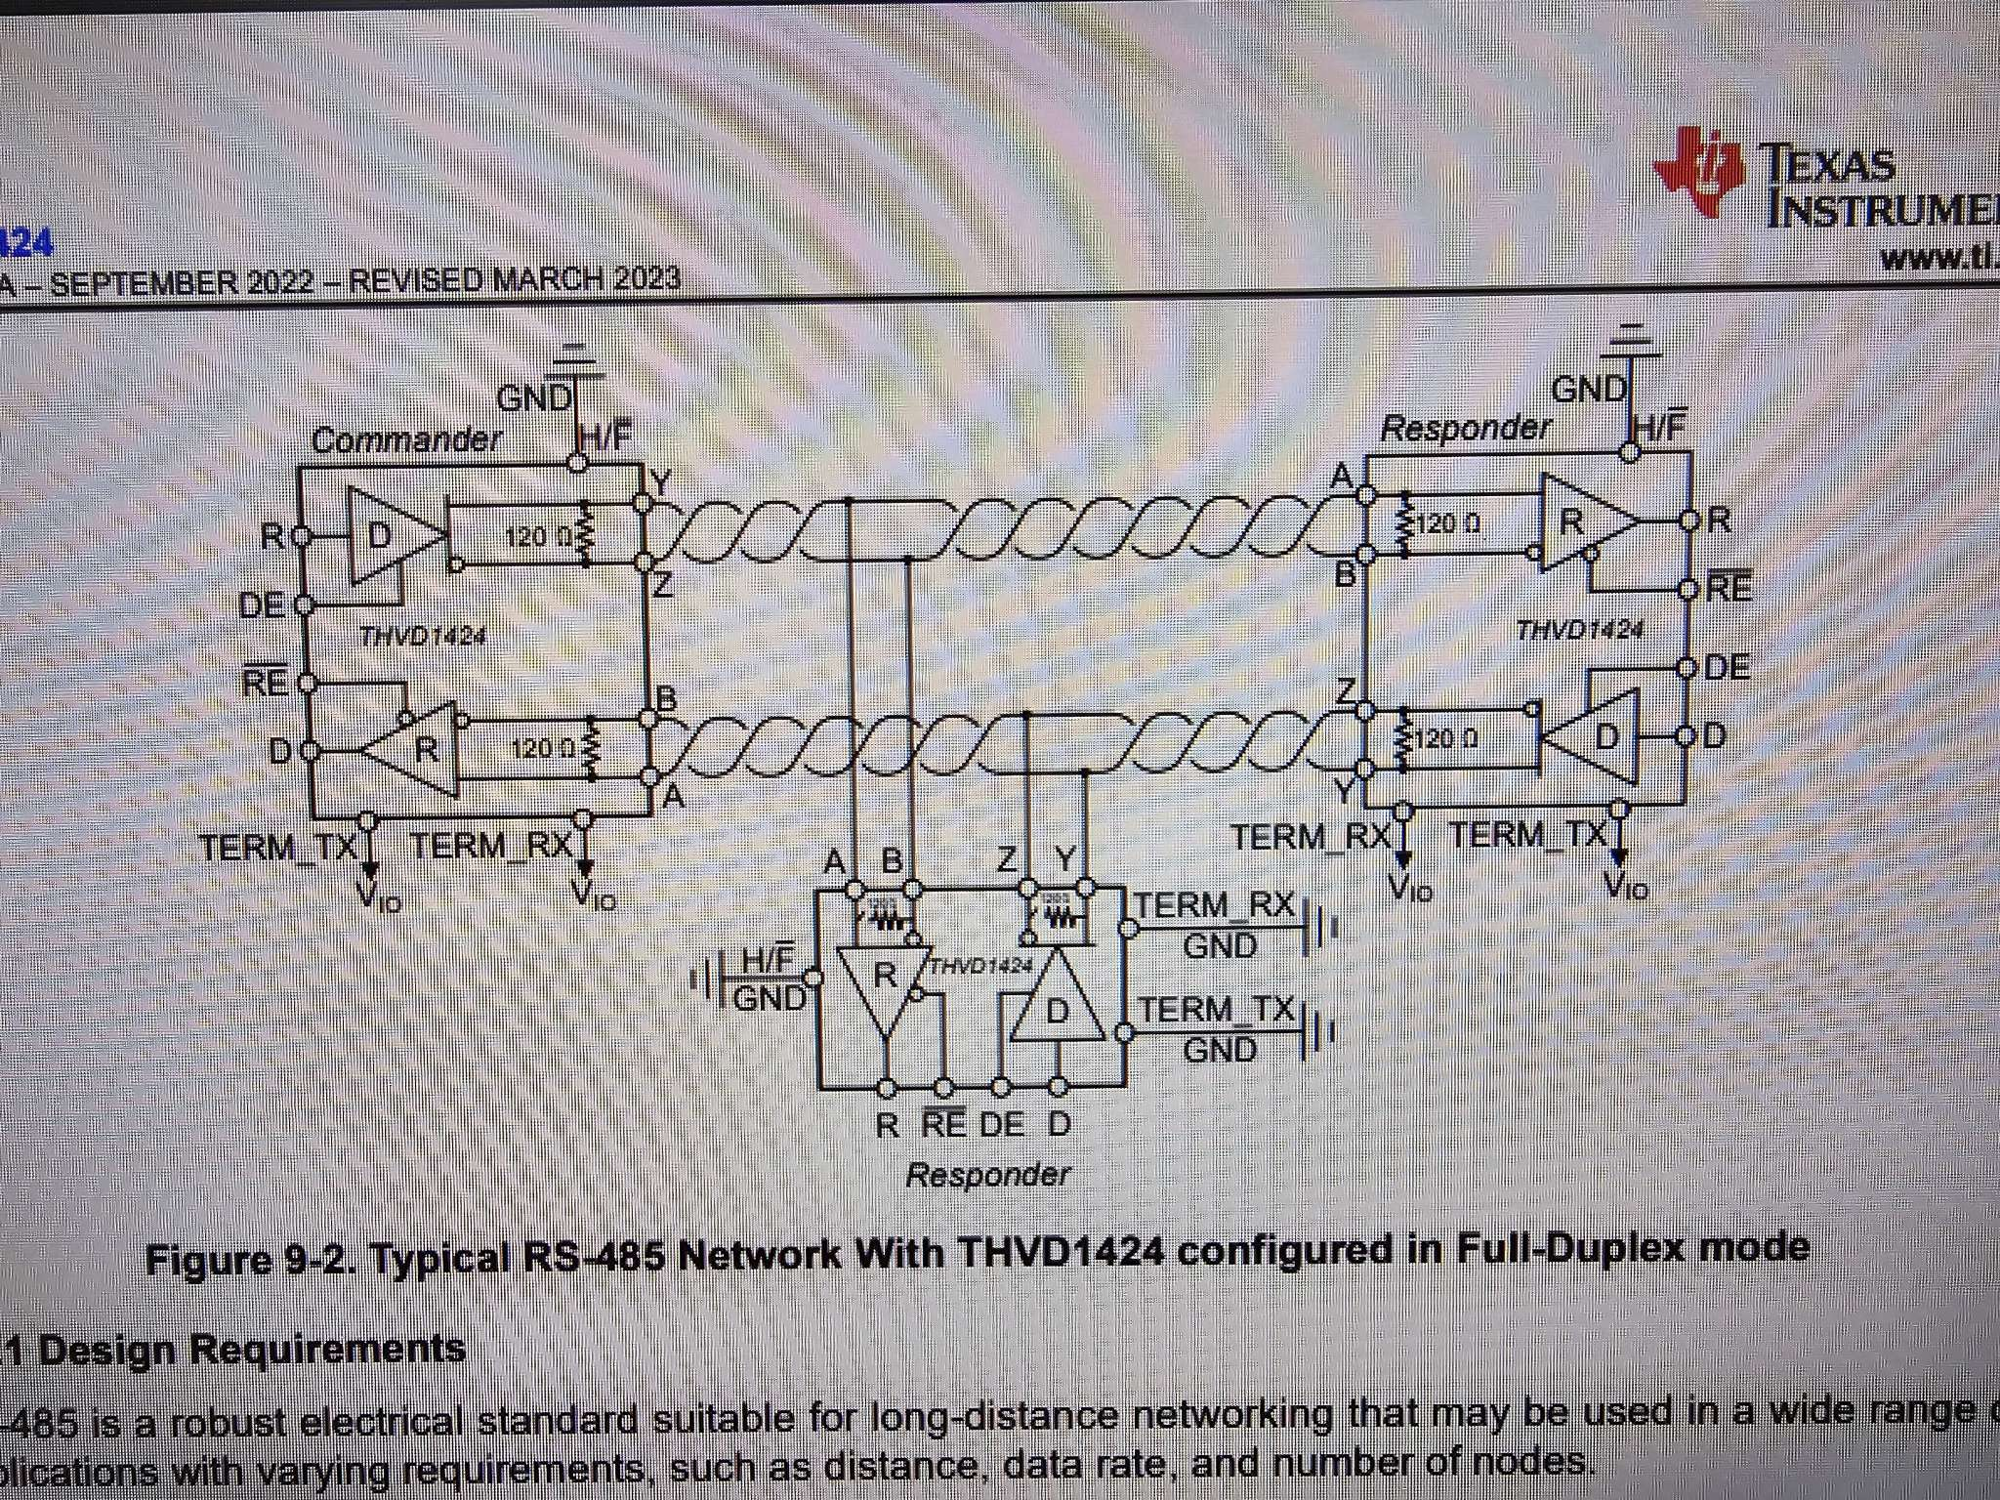

Slide 4
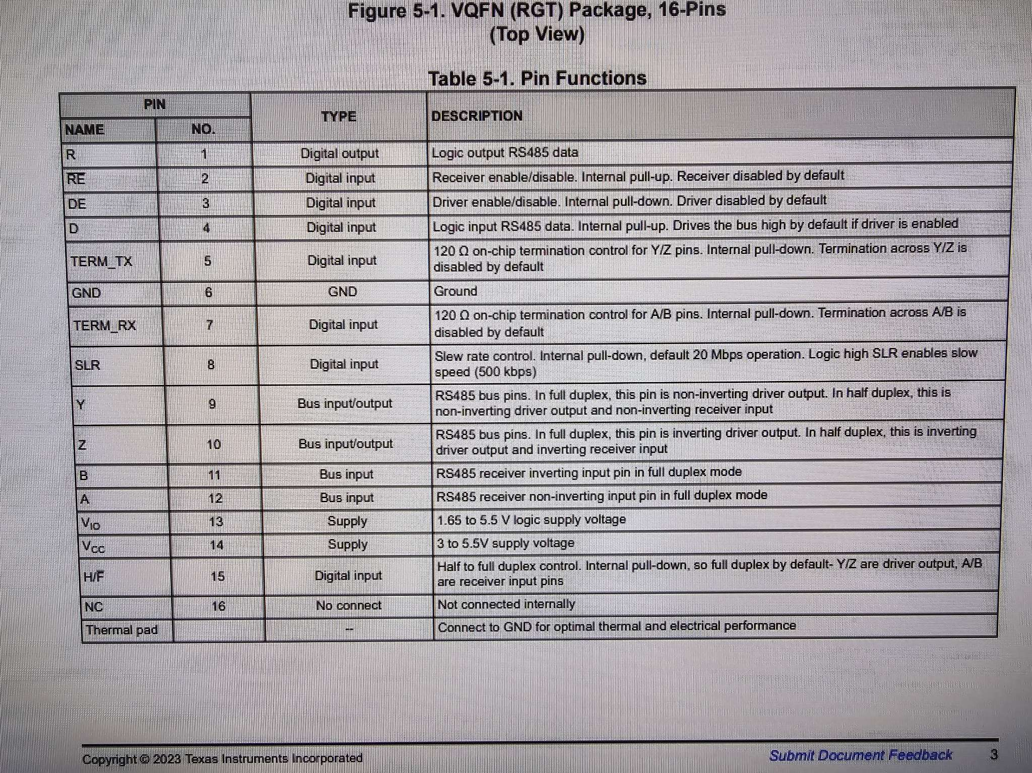

Slide 5
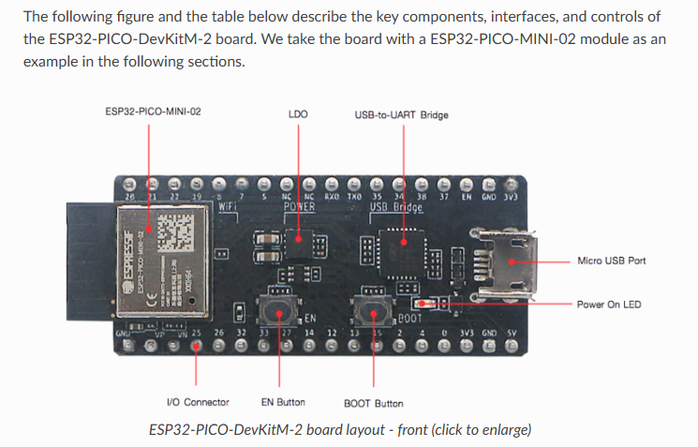
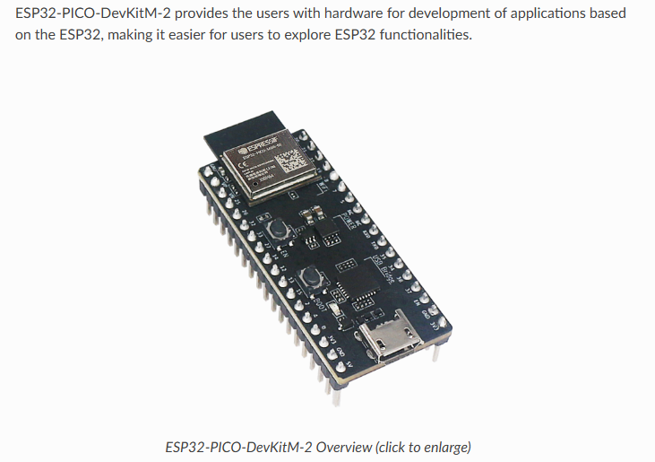

Slide 6
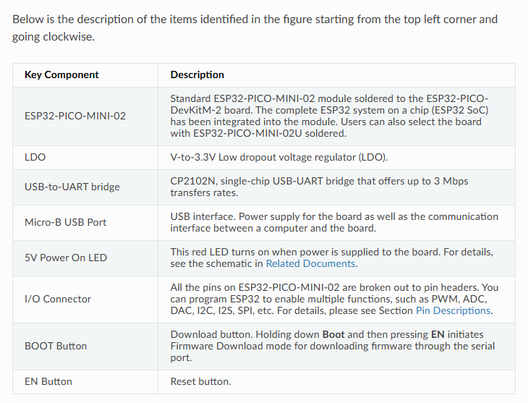

Slide 7
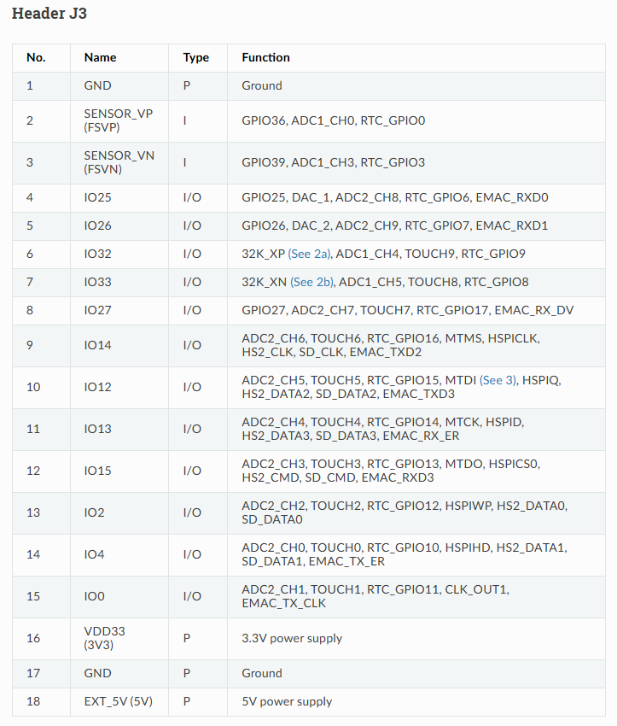
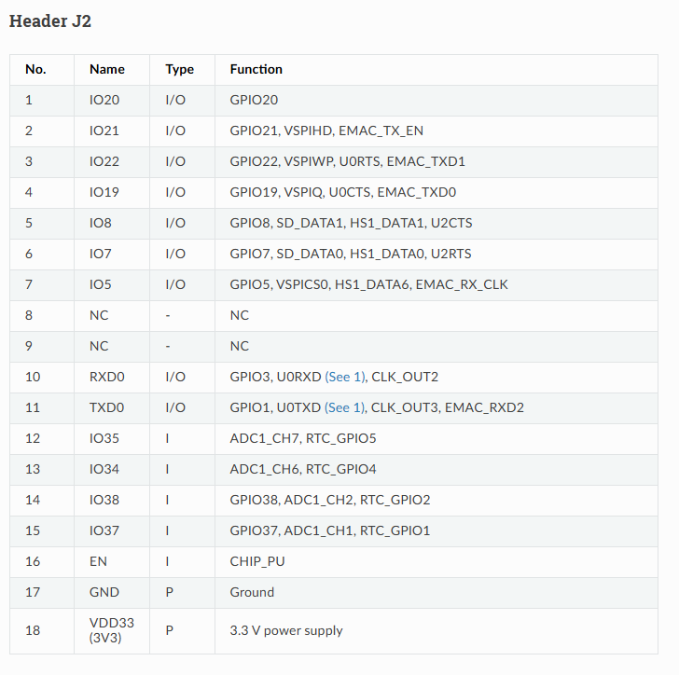

Slide 8
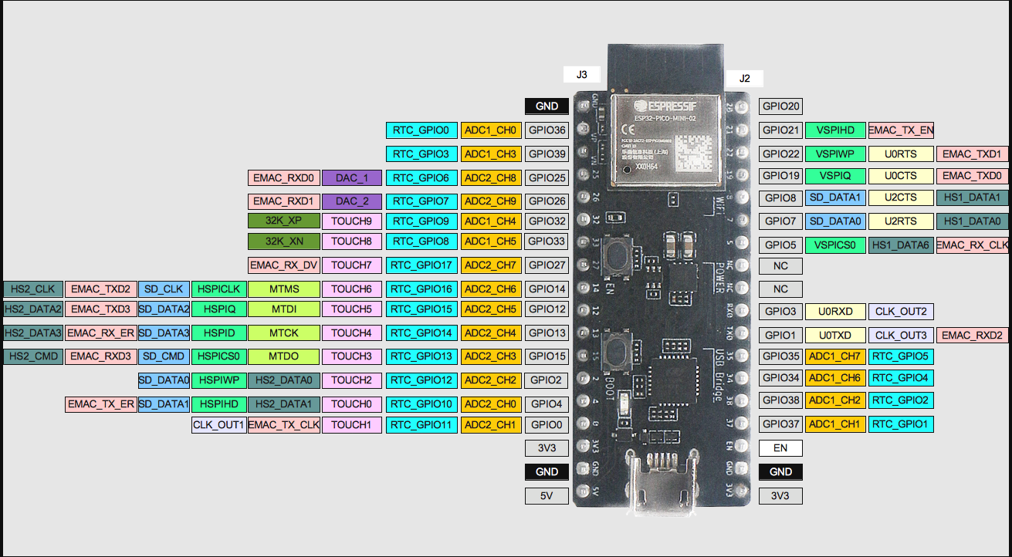

Slide 9
#define RXD0 3 // UART0 RX pin #define TXD0 1 // UART0 TX pin #define RXD1 5 // UART1 RX pin #define TXD1 4 // UART1 TX pin void setup() { Serial.begin(115200); // Initialize Serial Monitor // Initialize UART0 Serial.begin(9600, SERIAL_8N1, RXD0, TXD0); Serial.println("UART0 initialized"); // Initialize UART1 Serial1.begin(9600, SERIAL_8N1, RXD1, TXD1); Serial1.println("UART1 initialized"); } void loop() { // Send data through UART0 Serial.println("UART0: Hello from UART0!"); // Send data through UART1 Serial1.println("UART1: Hello from UART1!"); delay(1000); // Delay for readability }

Slide 10
